Slide 2
Lecture 32 DISCRETE STRUCTURE
SARA SHAFIQUE

Slide 3

Traversing/Accessing a Tree
There are three possible methods to travers a tree.
Level by Level
Pre-Order(Depth First Order)
Post-Order(Suffix Walk)

Slide 4
1) Level by Level Traversing
Algorithm
Access root node.
Increment level by 1.
Access all nodes from left to right.
Go to step b)
If there is no further level, then end.

Slide 5
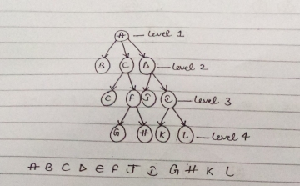
1) Level by Level Traversing Example

Slide 6
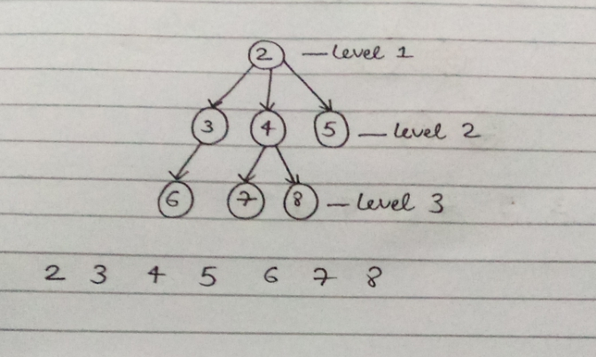
Level by Level Traversing Example

Slide 7
2) Pre-Order Traversing (Depth First Order)
Algorithm
Access root node/Parent node.
If it has a children then access its leftmost child and goto step no c).
If it has a brother then access its twin younger brother then go to step no b).
Go to its parent.
If it’s root then end.

Slide 8
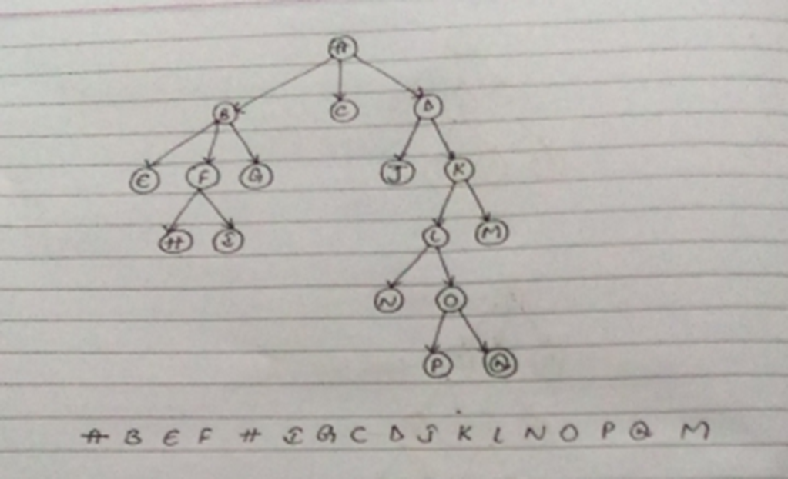
2) Pre-Order Traversing (Depth First Order) Example(PLR)

Slide 9
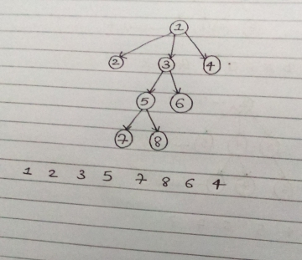
2) Pre-Order Traversing (Depth First Order) Example

Slide 10
3) Post Order Traversing (Suffix Walk)
Algorithm
Go-to Root
If it has children, then go to its left most child and access it
go to step a)
If it has a younger brother then go to its younger brother and go to step no b)
Access its parent
If it is root then end

Slide 11
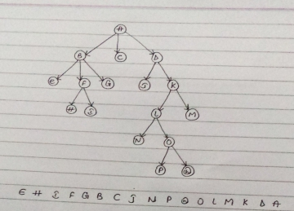
3) Post Order Traversing (Suffix Walk)(LRP) Example

Slide 12
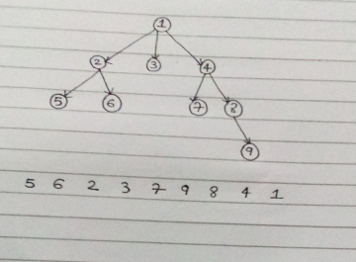
3) Post Order Traversing (Suffix Walk) Example

Slide 13

What is Queue?
A collection of entities that are stored in first in first out(FIFO) order.
Two Operations
Enqueue – Add Element
Dequeue – Remove Element

Slide 14

What is Stack?
A collection of entities that are stored in last in first out(LIFO) order.
Two Operations
Push – Add Element
Pop – Remove Element

Slide 15
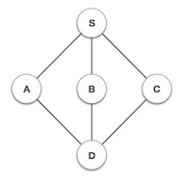
Breadth First Traversal
Rule 1 − Visit the adjacent unvisited vertex. Mark it as visited. Display it. Insert it in a queue.
Rule 2 − If no adjacent vertex is found, remove the first vertex from the queue.
Rule 3 − Repeat Rule 1 and Rule 2 until the queue is empty.

Slide 16
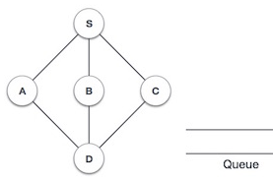
Breadth First Traversal

Slide 17
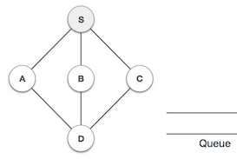
Breadth First Traversal
Output: S

Slide 18
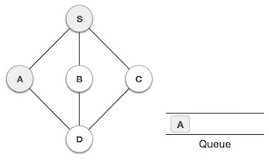
Breadth First Traversal
Output: S A

Slide 19
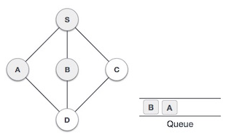
Breadth First Traversal
Output: S A B

Slide 20
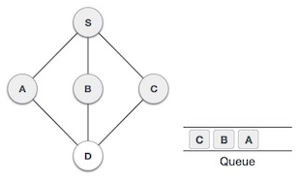
Breadth First Traversal
Output: S A B C

Slide 21
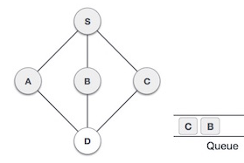
Breadth First Traversal
Output: S A B C

Slide 22
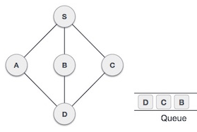
Breadth First Traversal
Output: S A B C D

Slide 23
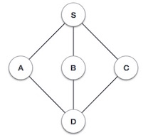
Depth First Traversal
Rule 1 − Visit the adjacent unvisited vertex. Mark it as visited. Display it. Push it in a stack.
Rule 2 − If no adjacent vertex is found, pop up a vertex from the stack. (It will pop up all the vertices from the stack, which do not have adjacent vertices.)
Rule 3 − Repeat Rule 1 and Rule 2 until the stack is empty.

Slide 24
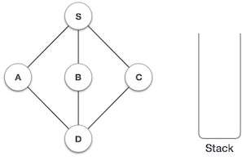
Depth First Traversal

Slide 25
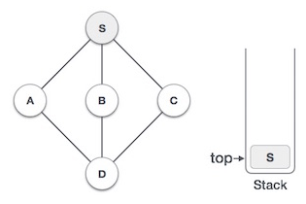
Depth First Traversal
Output: S

Slide 26
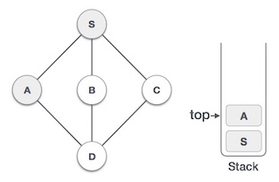
Depth First Traversal
Output: S A

Slide 27
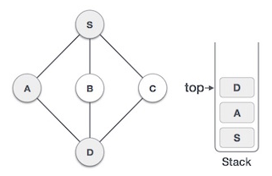
Depth First Traversal
Output: S A D

Slide 28
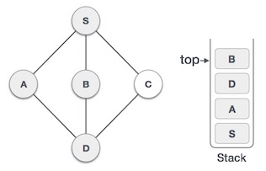
Depth First Traversal
Output: S A D B

Slide 29
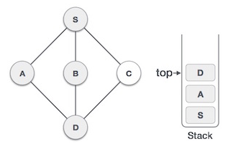
Depth First Traversal
Output: S A D B

Slide 30
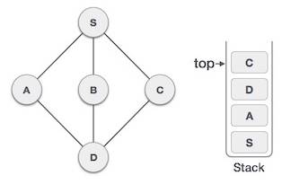
Depth First Traversal
Output: S A D B C

Slide 31
Pascal's Identity
is a useful theorem used to simplify complicated expressions involving binomial coefficients.
Pascal's Identity is also known as Pascal's Rule, Pascal's Formula, and occasionally Pascal's Theorem.

Slide 32
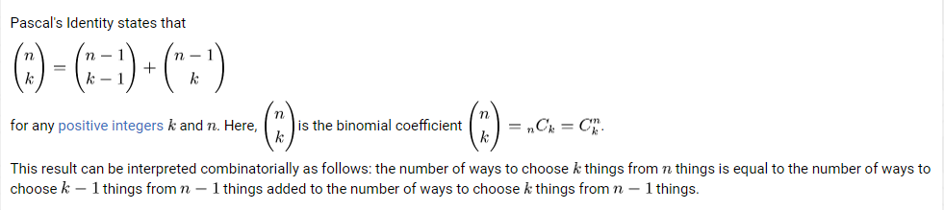

Slide 33
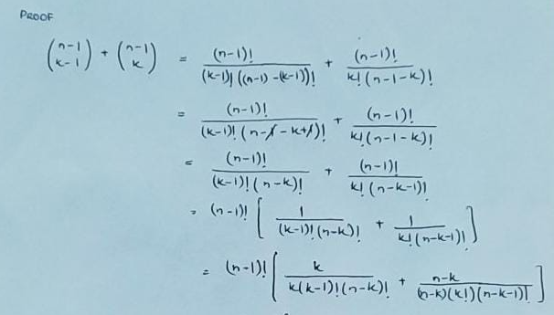


Slide 34
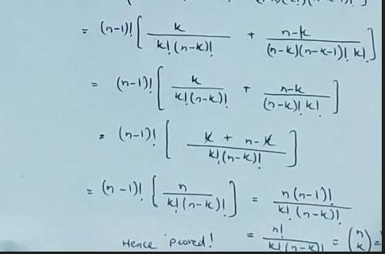

Slide 35
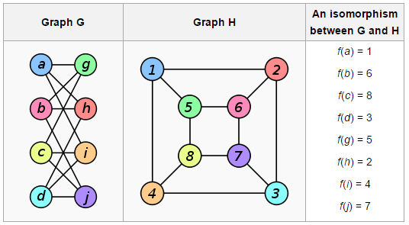

Slide 36
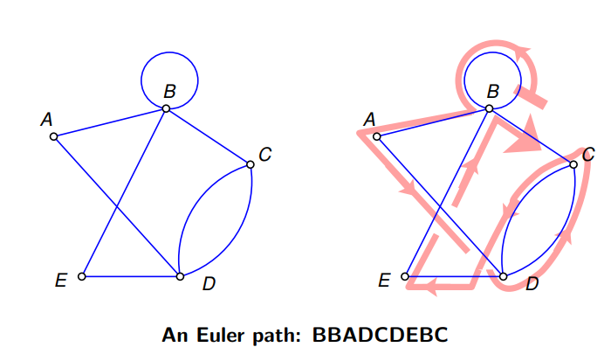
Euler path
An Euler path is a path that uses every edge of a graph exactly once.

Slide 37
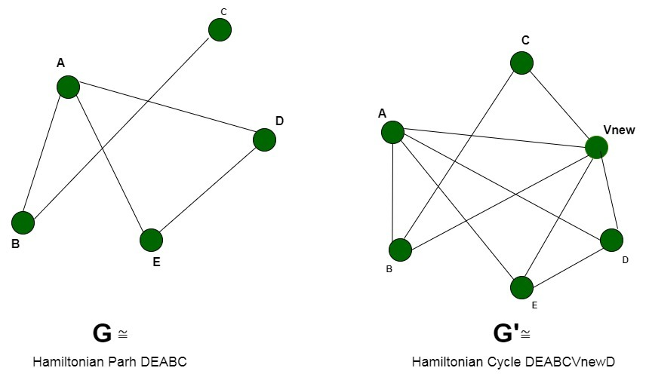
Hamiltonian path
The Hamiltonian path is a path, that visits each vertex exactly once

Slide 38
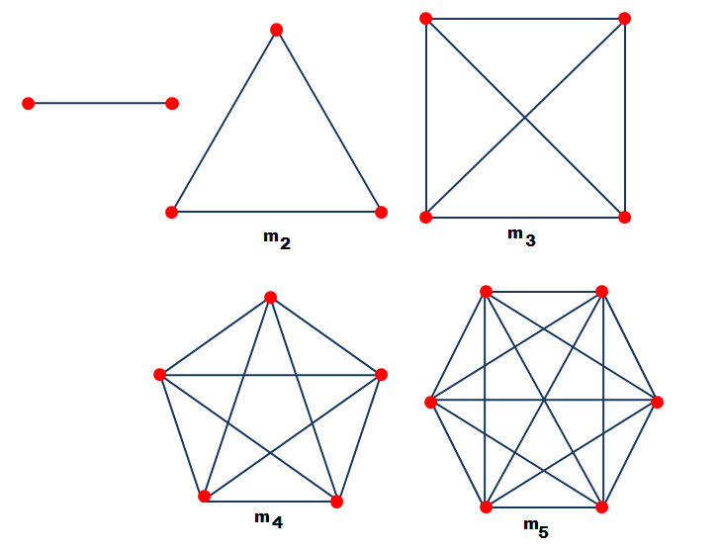
Complete graph
A complete graph is a graph in which each pair of graph vertices is connected by an edge.

Slide 39
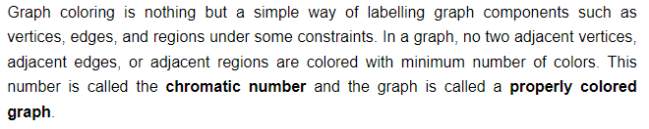
Graph Coloring

Slide 40
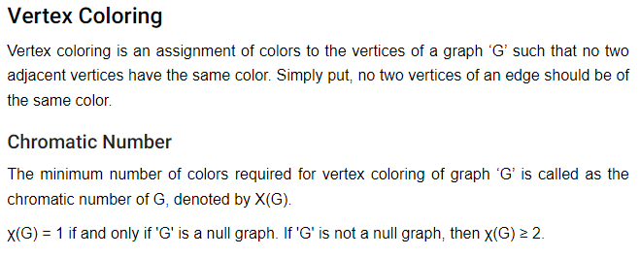
Graph Coloring

Slide 41
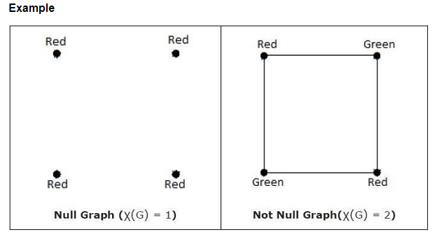
Graph Coloring

Slide 42
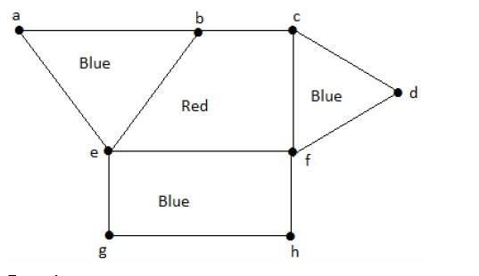
Region Coloring

Slide 43
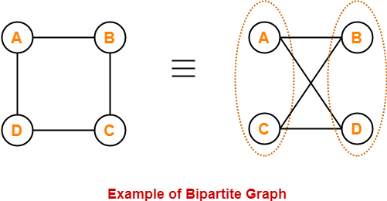

Slide 44
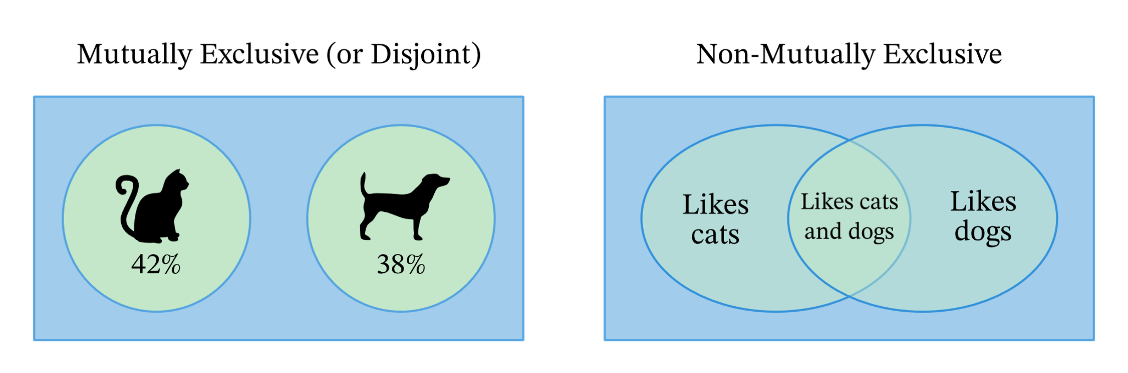

Slide 45
Inclusion and Exclusion Principle
If the events are not exclusive, this rule is known as the inclusion-exclusion principle.“
In other words, the total probability of a set of events is the sum of the individual probabilities of each individual event, minus the overlap (the probability of the events happening at the same time).

